Slide 1
Nineteen Trading Company Limited

Slide 2
Website Development

Slide 3
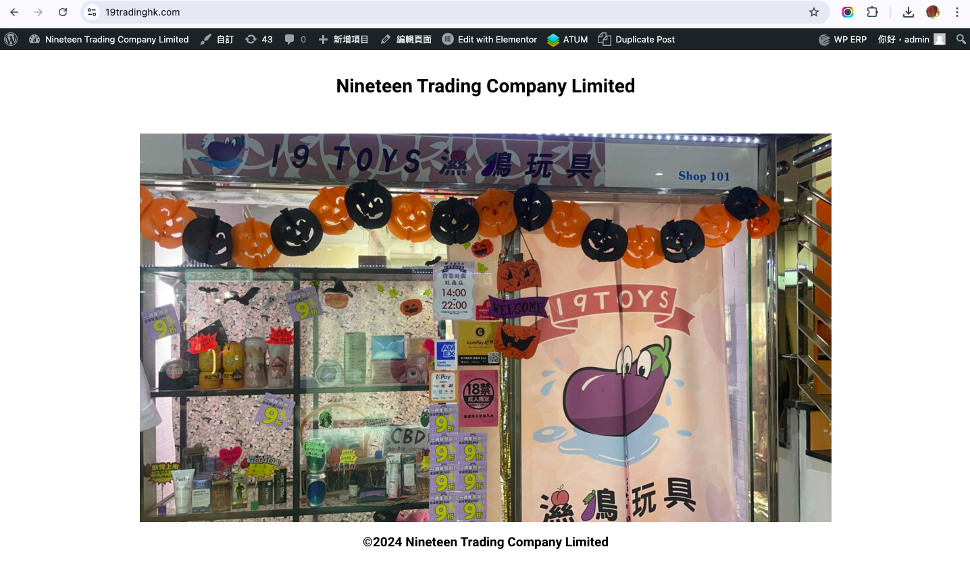
General Requirement:
1 Language

Slide 4
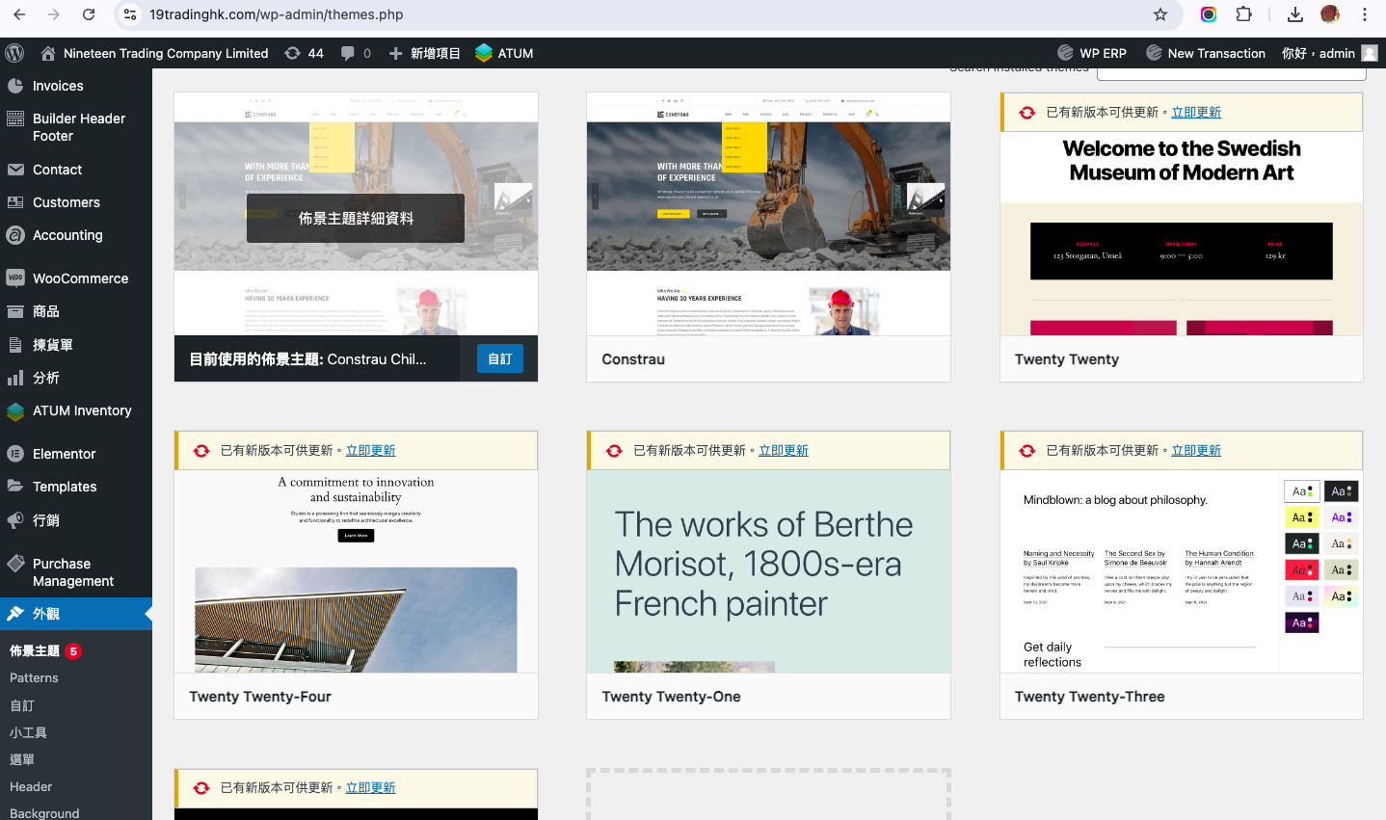
Choose a dashboard template provided

Slide 5
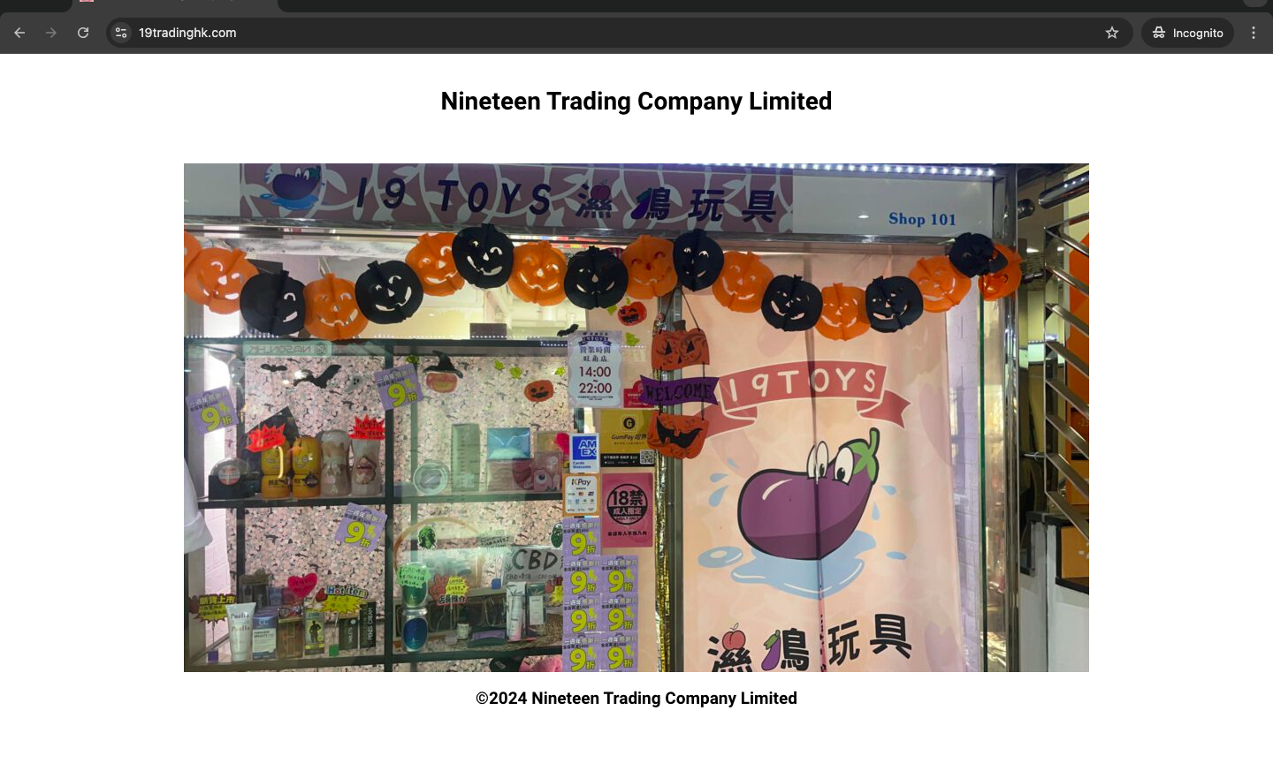
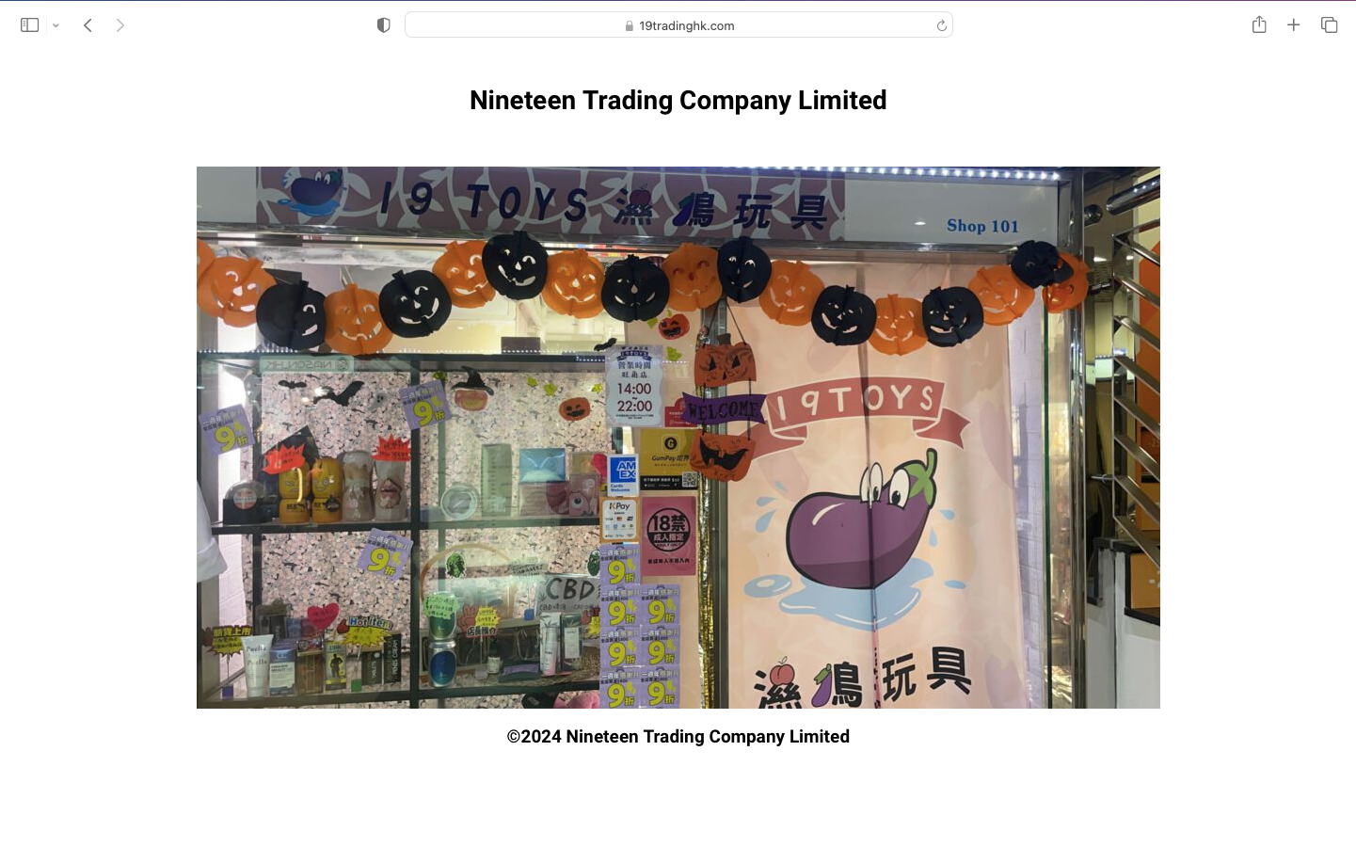
chrome
Safari
Combability: with IE11, latest version FF , chrome and Safari

Slide 6
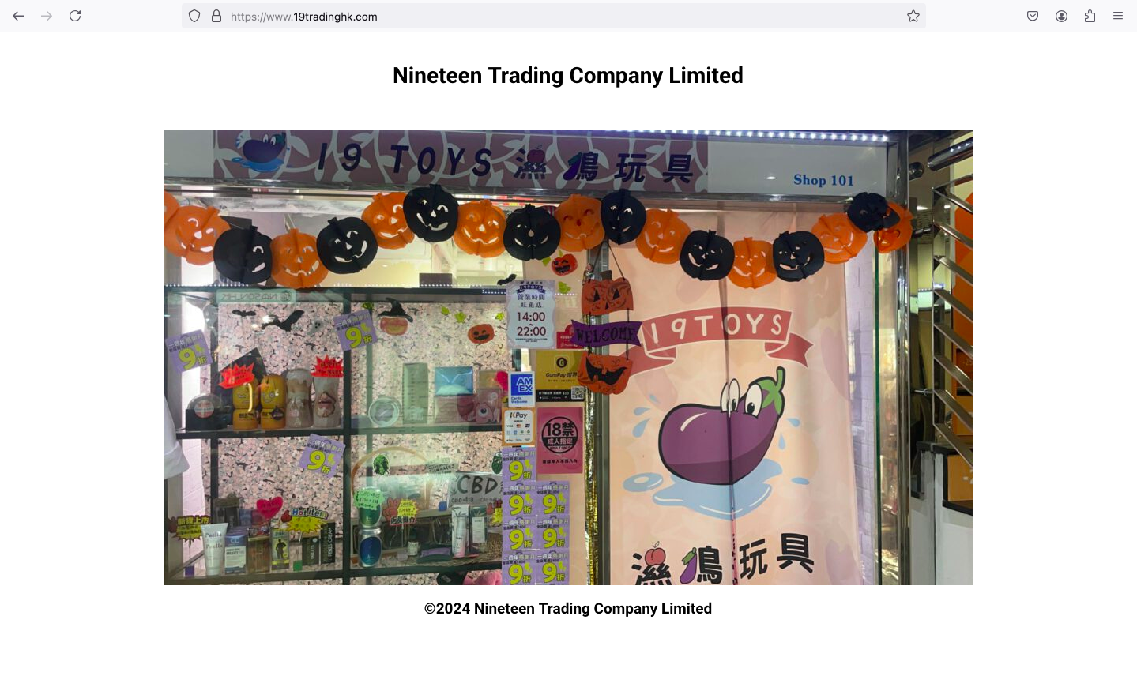
Firefox

Slide 7
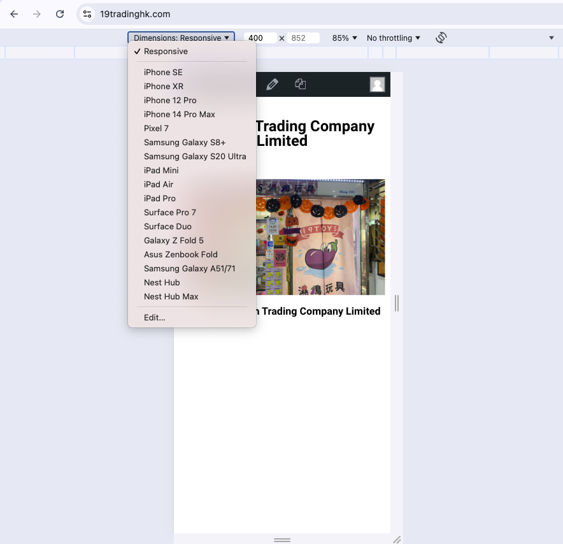
The platform should be mobile responsive

Slide 8
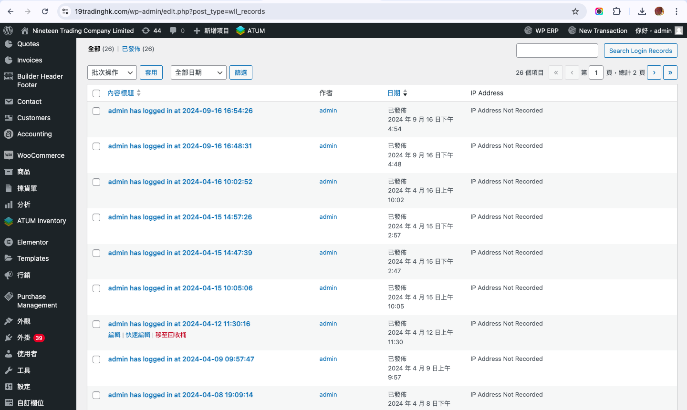
Should provide administrative function to manage User Access List (ACL)

Slide 9
CRM

Slide 10
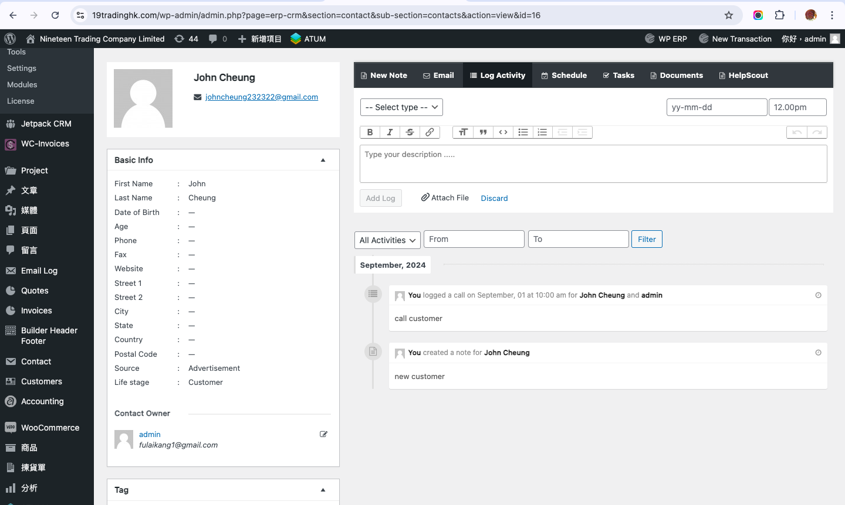
Contact Management:
Store and organize customer details, including contact
information, communication history, and relevant notes.

Slide 11
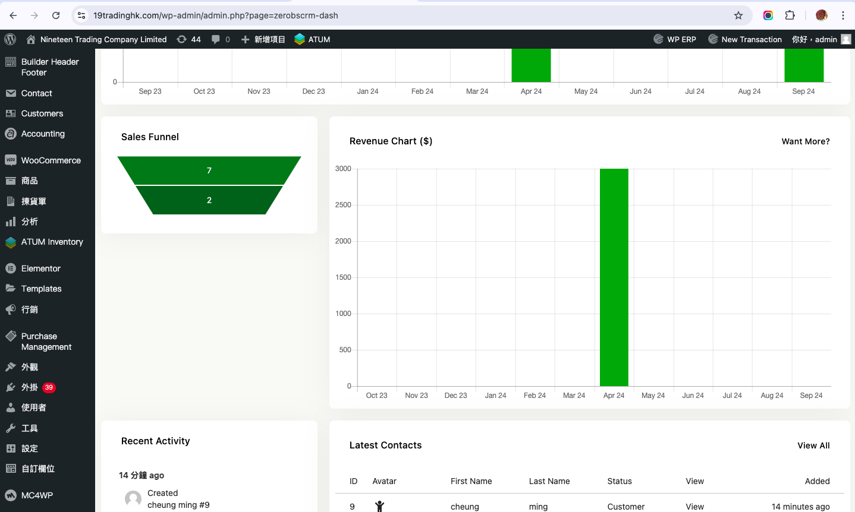
Lead Management:
Track and manage potential customers (leads) through various
stages of the sales funnel.

Slide 12
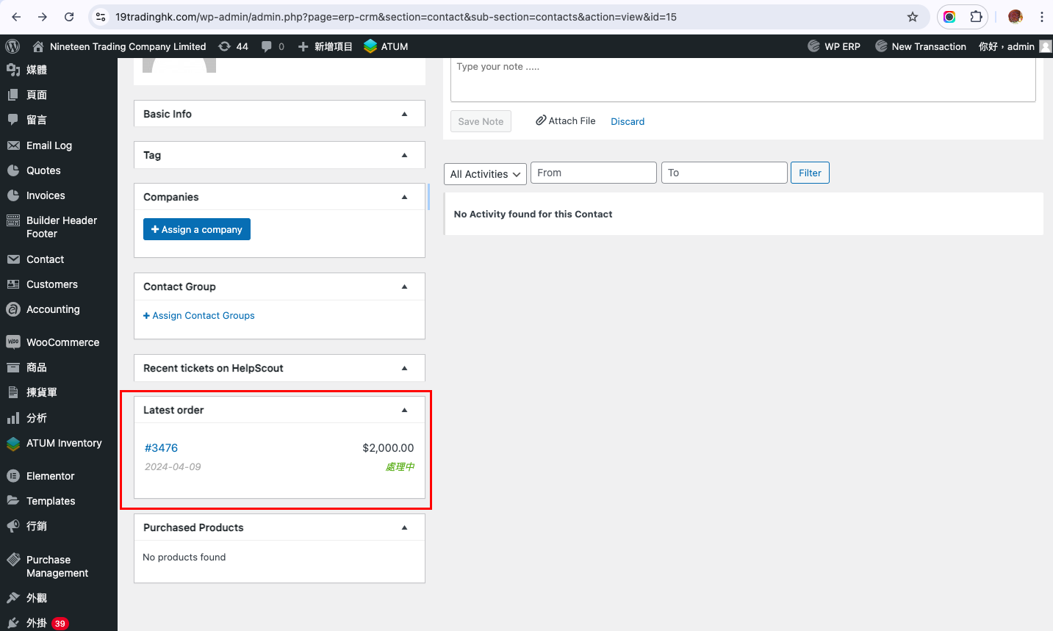
Opportunity Management:
Monitor and manage potential deals or sales opportunities,
including associated details and probability of closure.

Slide 13
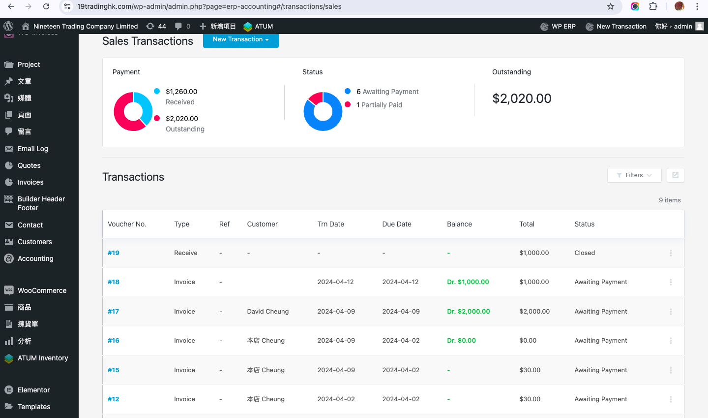
Sales Pipeline Tracking:
Visual representation of the sales process, allowing users to
track deals as they progress through different stages.

Slide 14
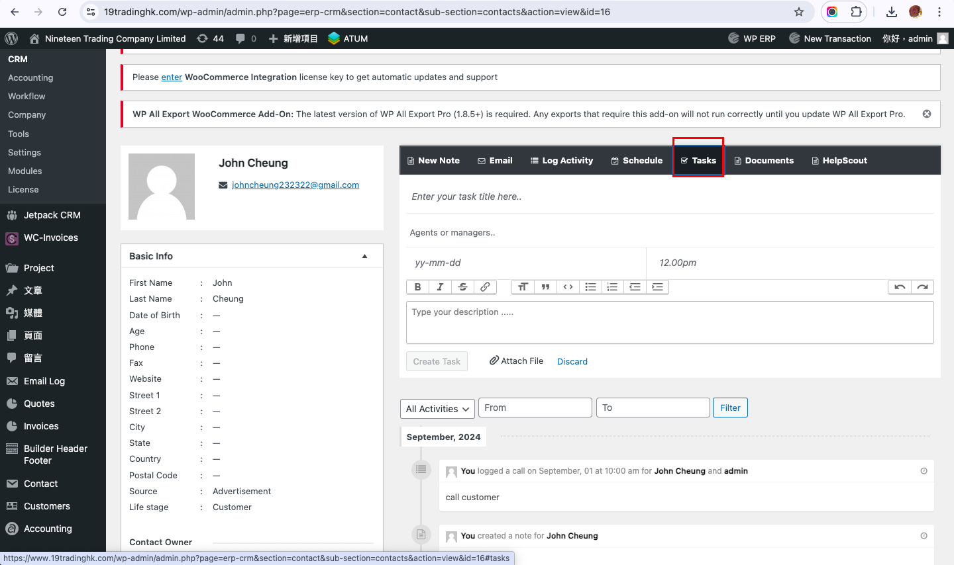
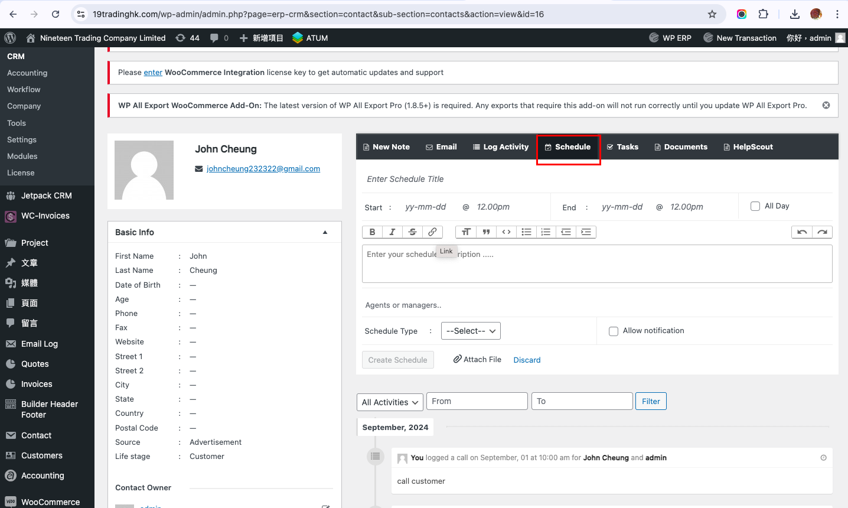
Task and Activity Management:
Schedule and track tasks, appointments, and follow-ups with
customers or leads.

Slide 15
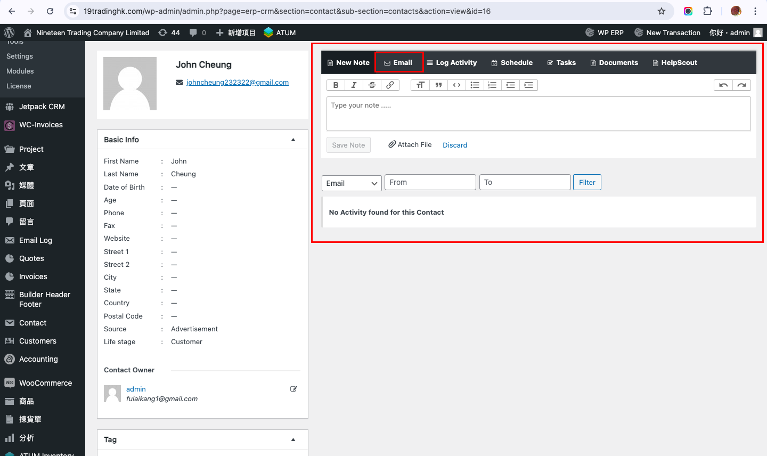
Email Integration:
Connect and integrate with email platforms to track
communication history and streamline correspondence.

Slide 16
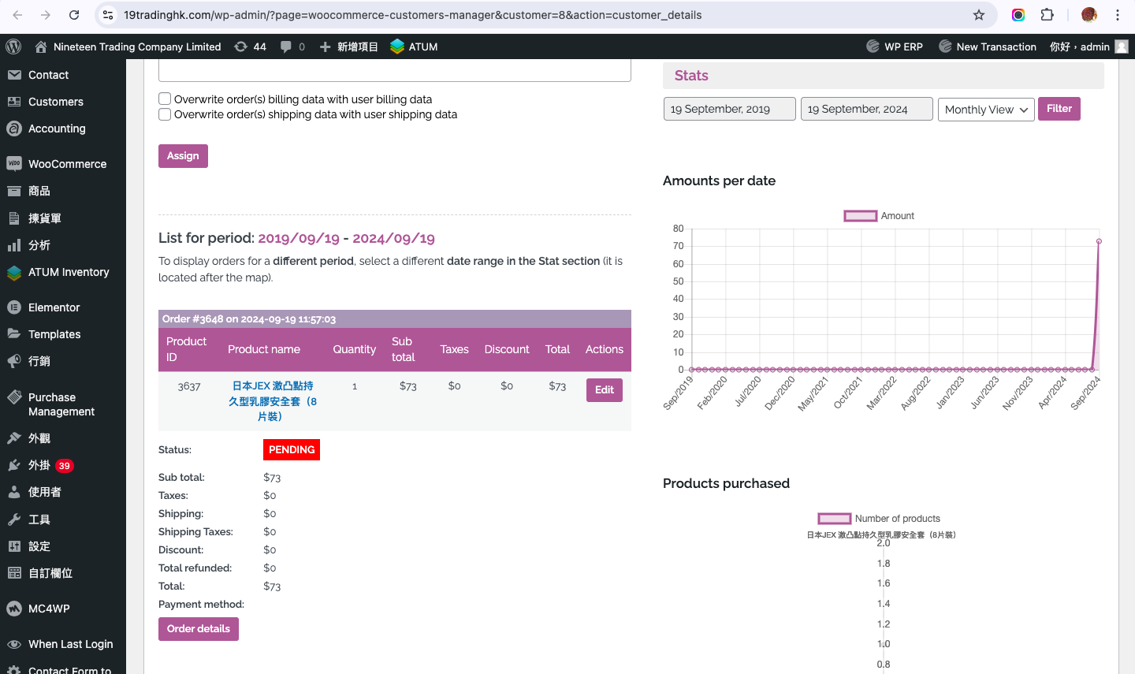
Reporting and Analytics:
Generate reports and analyze data to gain insights into sales
performance, customer behavior, and overall CRM effectiveness.

Slide 17
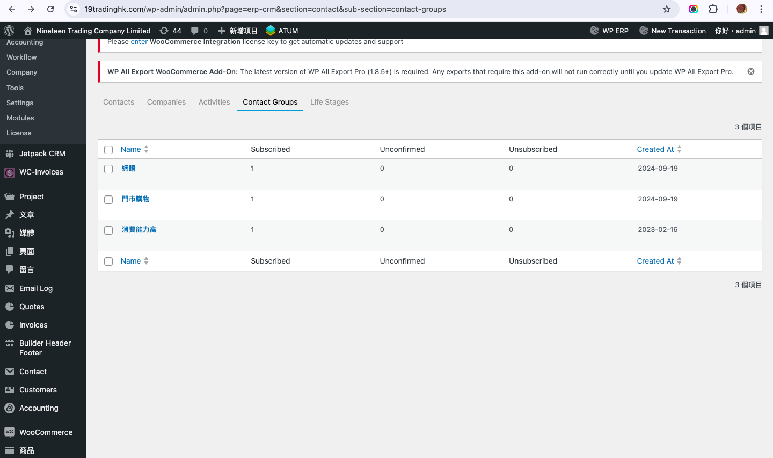
Customer Segmentation:
Categorize and segment customers based on various criteria for
targeted marketing and communication.

Slide 18
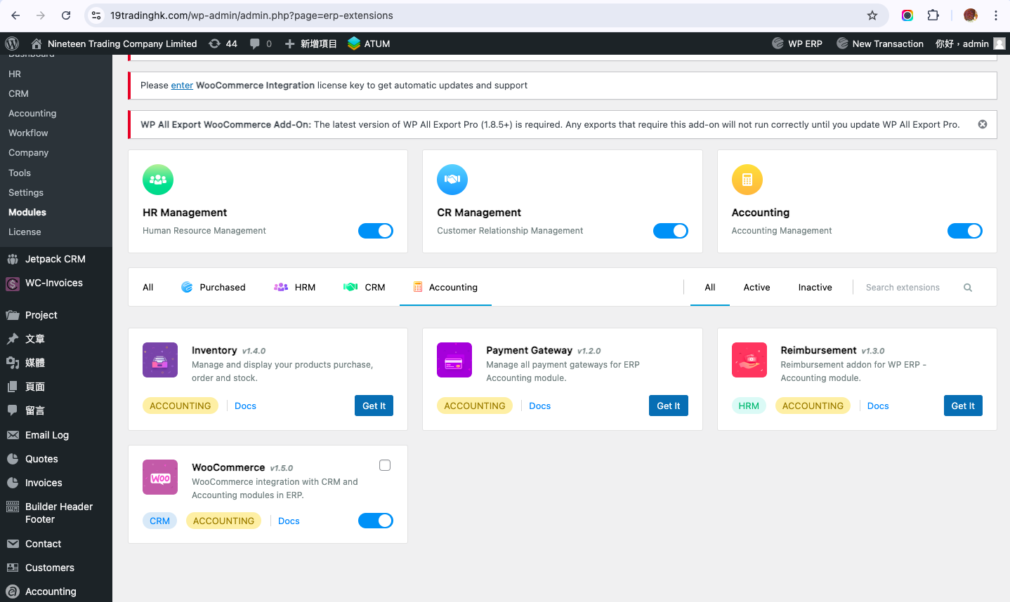
Integration with External Systems:
Able to provide connectivity to connect with other business
systems, such as marketing automation, accounting, or ERP
systems, for seamless data flow.

Slide 19
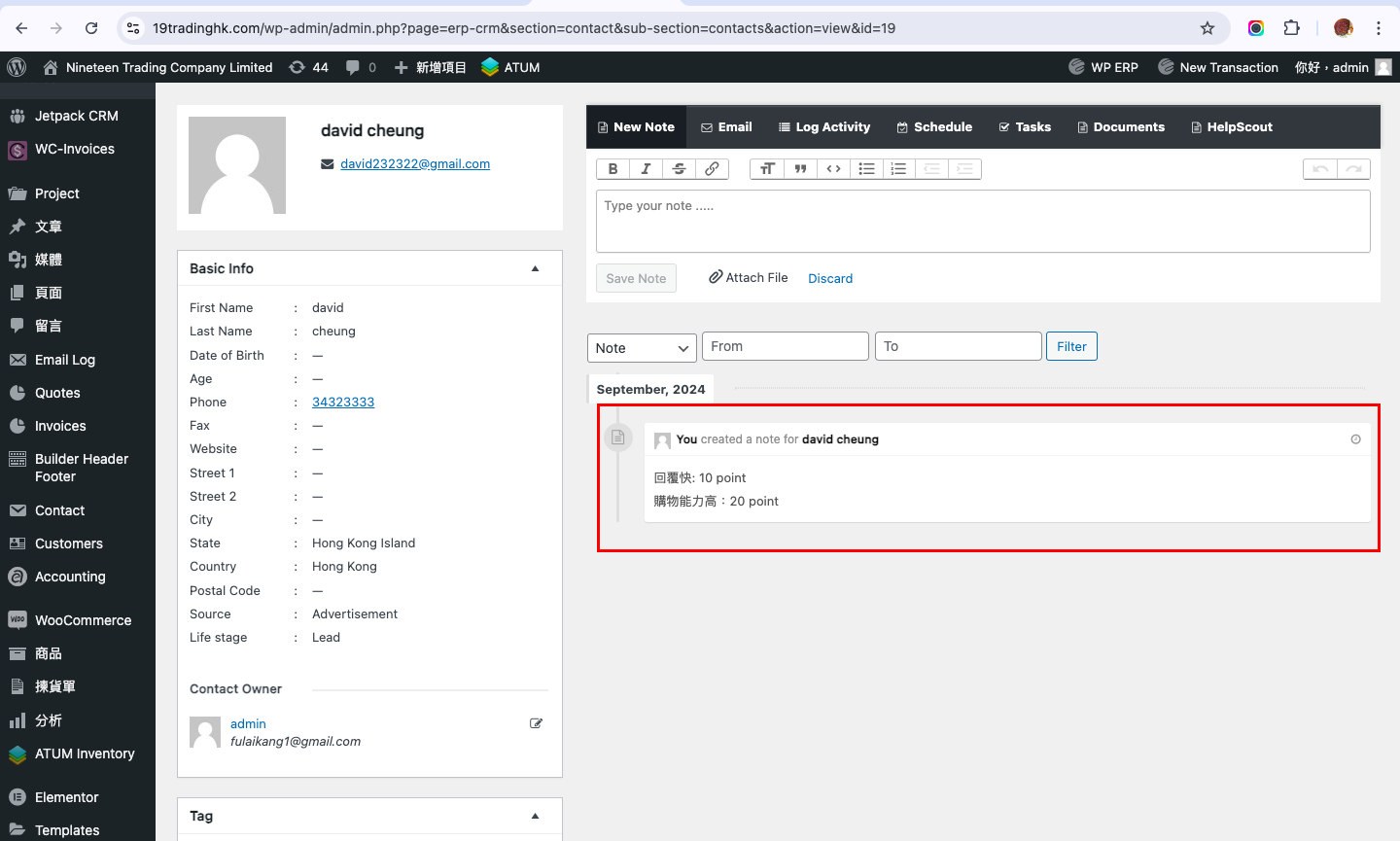
Lead Scoring:
Assign scores to leads based on their characteristics and
behaviors to prioritize high-potential opportunities.

Slide 20
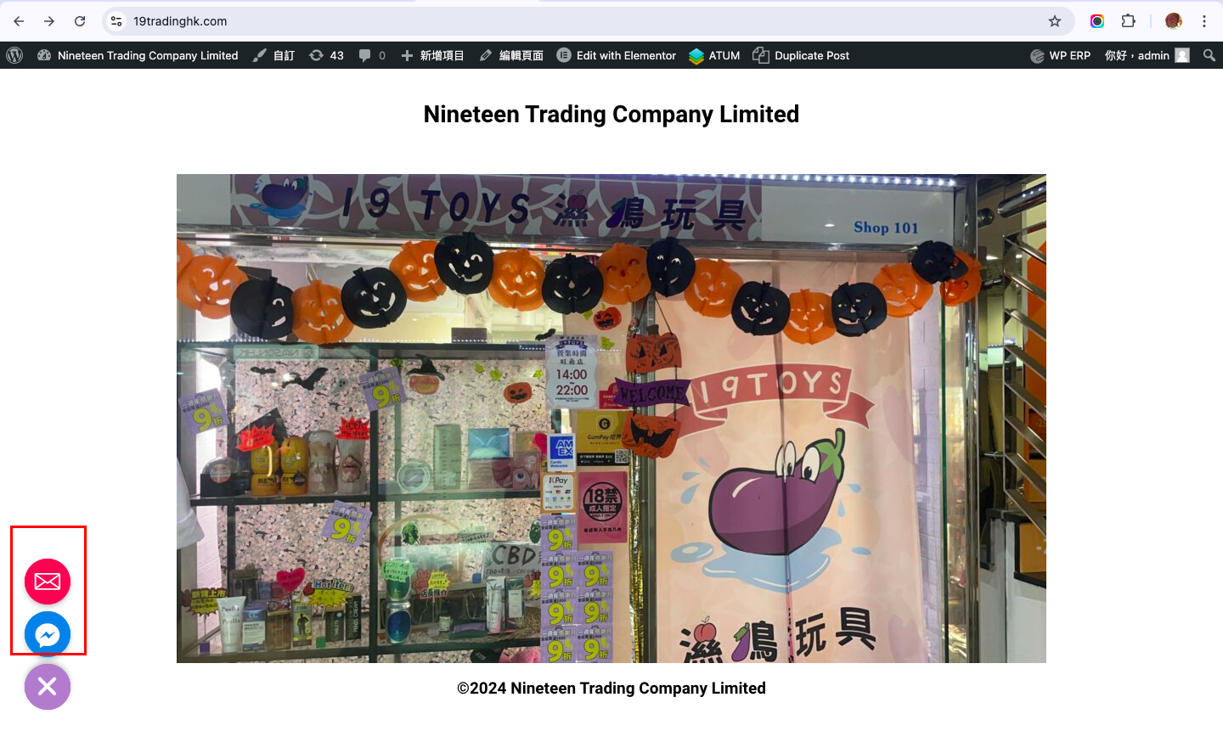
Multi-Channel Communication:
Support communication through various channels, such as email,
or chat

